Slide 1

College Football Predictive Analytics
Wyatt Rasmussen
DSC 630
Notes:
Introduce Myself
Mention DSC 630 at Bellevue

Slide 2

College Football Today
130 Football Bowl Subdivision (FBS) teams
Lower divisions of teams as well
Playoff of the top 4 teams
Playoff rankings released every Tuesday
Top 25 teams
Playoff committee = 13 members
Current and former players, coaches, and athletic directors
Remove the bias!
Notes:
NCAA 3 Divisions
- D1 FBS is the focus
Playoff at the end of the season has the top 4 teams, could be switching to more in the future
- Could be 8 or 12 teams in the future, which is important to think about in the context of this project
Weekly Playoff rankings starting in week 8
Halfway through the season they begin releasing rankings
Generally quite a few surprises
Playoff committee
- Current and former players, coaches, and ADs
May have played for, coached, or work at schools they are ranking
REMOVE BIAS

Slide 3
How we can help
Unbiased Rankings
Predict Outcomes of Games
Create a results-based ranking
Should be unbiased
Value head-to-head results
Determine the outcome of games
Have better games for the end of the season playoff
Determine the best teams
Notes:
2 Main Goals
No bias in the ranking system
Accomplished with results based-ranking
Winning against good teams matters, margin of victory, etc.
Unbias
All teams on a level playing field
Head to head is important!
Predict the outcomes of games
Determine future outcomes
Helps us get the best teams on the field
Compare teams using predictive analytics to get how close the games would be
This would drive better viewership and better games

Slide 4
Building the Ranking System
Using Elo ranking system
Margin of victory plays a role
Beating a good team has larger impact than beating bad team
All teams start at same ranking each season
Lower division teams given lower ranking
Notes:
Elo Ranking System, named after a Hungarian-American physicist Arpad Elo
Reference the equation at the top of the screen
R’A is new rating for team A
RA is the current pregame rating
K is the absolute value of margin of victory
Sa is the actual score for team A (0 for loss, 1 for win)
Ea is the expected score for team A (probability of winning)
This ensures margin of victory plays a role
Beating a good team has a larger impact
All teams start on level playing field with a value of 1000
Lower division teams are all set at 500
This rewards playing tougher games

Slide 5
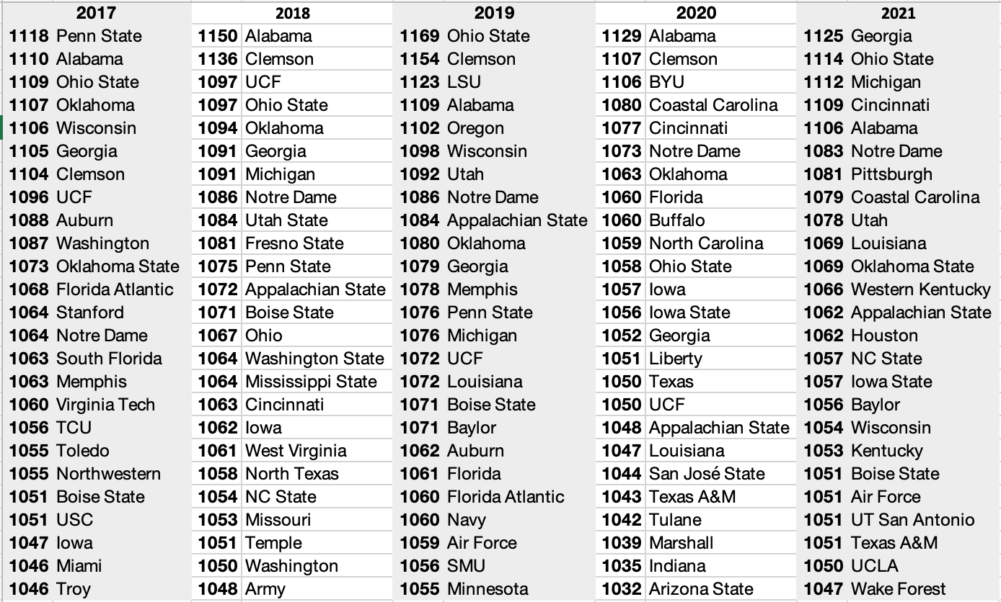
Results of Ranking system
Top 25 teams
Elo Ranks next to team
Notes:
Top 25 teams each season
Elo Rank is next to the team
National Champions
2017 – #2 Alabama
2018 - #2 Clemson
2019 - #3 LSU
2020 - #1 Alabama
2021 - #1 Georgia
Success as we would have included the champion in all 5 playoffs.
Not all ranked 1st because upset could happen

Slide 6
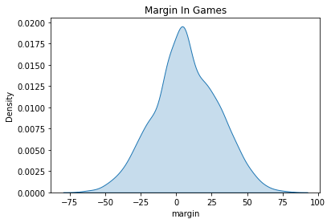
Margin of the Games
Normally distributed
Negative is away team winning
Positive is home team winning
Notes:
Prior to getting into the building of the model I wanted to run through some graphs that would have an impact in building the model
Margin of games is normally distributed with all else ignored, good sign but could make things difficult
It seems to be centered just to the right of 0 so a positive number
Negative = Away Win
Positive = Home Win

Slide 7
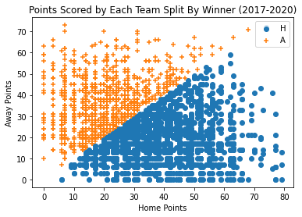
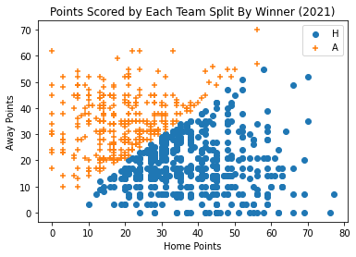
Scatter Plots of Points Scored by each team
2017-2020
2021
Notes:
Orange pluses are away teams winning
Blue circles are the home team winning
A few notes
X-axis stretches longer than y-axis
Seem to be a little more blue than orange

Slide 8
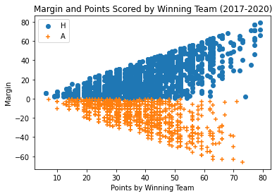
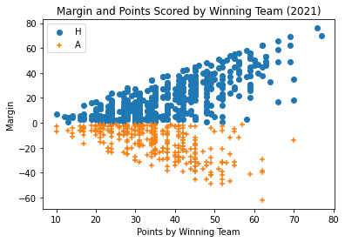
Scatter Plots of margin & Points Scored by Winning team
2017-2020
2021
Notes:
Orange pluses are away teams winning
Blue circles are the home team winning
Created a really interesting chart
Pretty even spread across both
Blue dots are a little heavier in the points scored by winning team (this tells us that in high scoring affairs that home teams have a slight advantage)

Slide 9
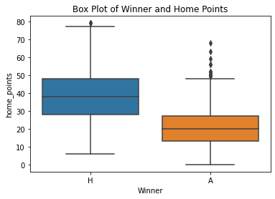
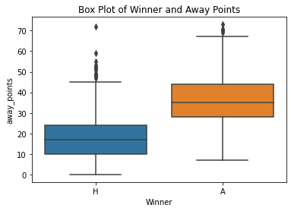
Box and whisker plots separated by winner and points
Home Points Scored
Away Points Scored
Notes:
Left chart
Blue was the winning team
Orange was the losing team
Right Chart
Orange was the winning team
Blue was the losing team
I found it interesting to look at the points scored by winning and losing teams Losing teams the end of the whisker was topped out at the top of the winners box
Means it is not common to be scoring that many for losing teams
Home teams also ended up a bit higher on the points scored

Slide 10
Building the Prediction Model
Predicting Margin
Predicting Win/Loss
Trying to accurately predict the margin of games
Regression type algorithms
Machine learning from margin from previous years
Using two different methods
Using just the Elo rank I created
Using Elo rank and also the conference each team was in
Trying to accurately predict the winner and loser of games
Classification algorithms
Machine learning from previous years
Using two different methods
Using just the Elo rank I created
Using Elo rank and also the conference each team was in
Notes:
Two types of models
Predicting margin
High degree of difficulty
Trying to predict the correct margin with just pregame information
Regression algorithms
Machine learning the margin from 2017-2020
Using two different methods
Just Elo rank
Using Elo rank and the conference
Predicting Win/Loss
Much easier
Accurately predict who wins and losses
Classification algorithms
Machine learning from 2017-2020
Using two methods
Just Elo rank
Using Elo rank and the conference

Slide 11
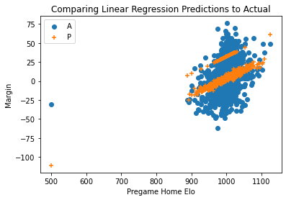
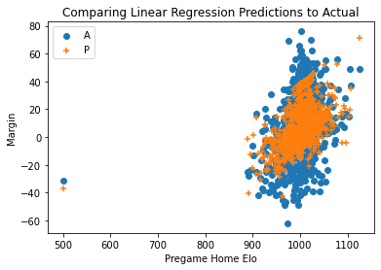
Results of Linear Regression Prediction Model
Less Variables
More Variables
R² = 0.2686
R² = 0.3826
Notes:
Linear Regression
Orange = Prediction
Blue = Actual
Less variables = using just the pregame elo rank
Less spread likely due to limited features
Decent R-squared, needs to be better
More variables = using elo and conference
More spread, starting to match the actual better
Improving r-squared

Slide 12
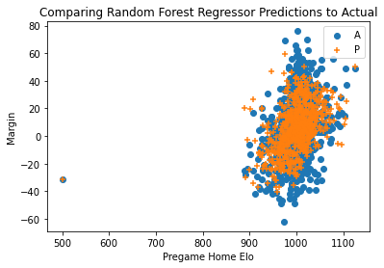

Results of Random Forest Regressor Prediction Model
Less Variables
More Variables
R² = 0.1401
R² = 0.2653
Notes:
Random Forest Regressor
Orange = Prediction
Blue = Actual
Less variables = using just the pregame elo rank
Not good R-squared, needs to be better
More variables = using elo and conference
More spread, starting to match the actual better
Improving r-squared by quite a bit

Slide 13
Results of Support Vector Regressor Prediction Model
Less Variables
More Variables
R² = 0.3319
R² = 0.2796
Notes:
Support Vector Regressor
Orange = Prediction
Blue = Actual
Less variables = using just the pregame elo rank
Less spread likely due to limited features
Decent R-squared, needs to be better
Likely underfitting here
More variables = using elo and conference
More spread, starting to match the actual better
Declining r-squared

Slide 14
What does this mean?
Based on the results here, it seems as though we get better results here when using more variables. The results tended to increase
Linear Regression and Support Vector Regressor had the best accuracies at predicting margin
Random Forest Regressor responded best to adding more variables
Notes:
We need to increase the amount of variables available to us to predict more accurately
Linear Regression and SVR did a decent job at predicting margin, but still a ways to go
Linear Regression and Random Forest Regressor responded well to adding more variables, this is where to focus efforst
Honestly the results we see here are pretty good. Las Vegas oddsmakers are generally the leaders in correctly predicting outcomes of games, in 2019 they had an R-squared of about 0.294
Added variables could be thing such as attendance, injuries, etc.

Slide 15
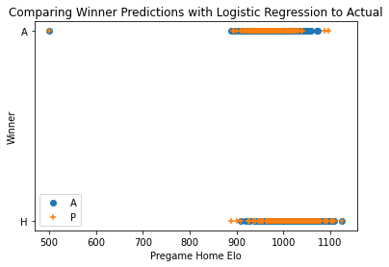

Results of Logistic Regression Prediction Model
Less Variables
More Variables
Accuracy = 0.6961
Accuracy = 0.7079
Notes:
Logistic Regression
- Better at getting 2 outcomes
Orange = Prediction
Blue = Actual
Less variables = using just the pregame elo rank
Good accuracy!!
Already much better at predicting winners than margin
More variables = using elo and conference
Slighlty better accuracy
Is it significantly different?

Slide 16
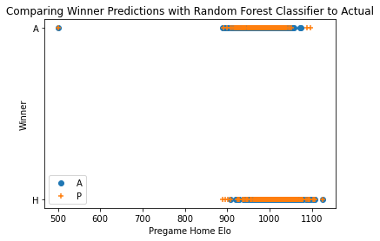
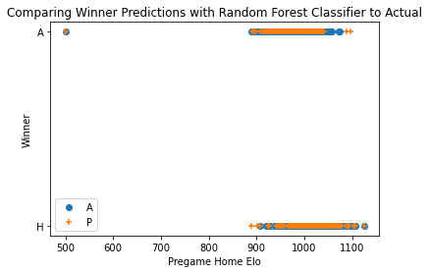
Results of Random Forest Classifier Prediction Model
Less Variables
More Variables
Accuracy = 0.6867
Accuracy = 0.6867
Notes:
Random Forest Classifier
Orange = Prediction
Blue = Actual
Less variables = using just the pregame elo rank
Good accuracy again
More variables = using elo and conference
Same accuracy
Means it didn’t respond much if at all to the added variables

Slide 17
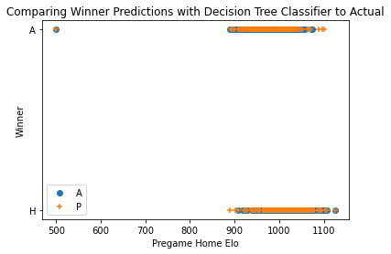
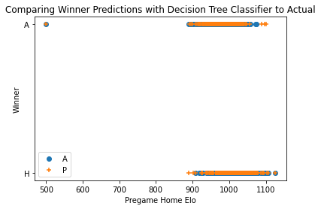
Results of Decision Tree Classifier Prediction Model
Less Variables
More Variables
Accuracy = 0.6408
Accuracy = 0.6396
Notes:
Decision Tree Classifier
Orange = Prediction
Blue = Actual
Less variables = using just the pregame elo rank
Worst accuracy of the bunch
Still not bad though
More variables = using elo and conference
Accuracy is getting worse with more variables… not good

Slide 18
What does this mean?
Based on the results here, it seems as though we get similar results here when using more variables. Using principles of Occam’s Razor we will use the results of less variables to prevent overfitting
Logistic Regression and Random Forest Classifier seem to be the best classifiers for this dataset
Decision tree classifier was rather underwhelming in comparison to the other two here
Notes:
Using Occam’s Razor it makes sense to use less variables here to avoid overfitting
Logistic Regression and Random Forest would be wise going forward.
Decision tree is underwhelming
Wonder if adjusting the ranking system would help here. More spread on the ranking could increase the accuracy of the models

Slide 19
Conclusion
Rankings
Predicting Games
The Elo system for ranking games appears rather successful
Consistently ranking the eventual national champion rather high
Helped to create a rather accurate predictive model
Predicting the margin is difficult, and would require features I didn’t have
Linear Regression and Support Vector Regressor
Random Forest Regressor
Predicting outright winner with just the rankings system was effective
Logistic Regression and Random Forest Classifier
Notes:
Rankings
Effective!!!
Consistently ranking the eventual national champion in the top 4, would capture them in top 8 or top 12 with expansion as well
Helped to create a rather accurate predictive model
Predicting games
Margin = Difficult
Need more features that I didn’t have
Advise using Linear Regression and SVR going forward
Outcomes
Much more effective
Logistic Regression and Random Forest Classifier was more effective.
How to Improve
Adjusting part of the Elo calculation can get me different accuracies in the model building. This would likely require some hyperparameter tuning to determine the best values to use here

Slide 20
Acknowledgements
I’d like to acknowledge Deependra Dhakal for the peer reviews throughout this process
I’d like to thank Fadi Alsaleem for being the professor to help through this project
Notes:
Thank you to Deependra Dhakal
Thank you to Professor Alsaleem

Slide 21
References
https://collegefootballdata.com/
https://collegefootballplayoff.com/sports/2016/9/30/overview.aspx
https://medium.com/purple-theory/what-is-elo-rating-c4eb7a9061e0
https://www.ncaa.com/news/football/article/college-football-national-championship-history
https://www.theonlycolors.com/2020/9/29/21492301/vegas-always-knows-a-mathematical-deep-dive

